Slide 1
HeuristicLab 4.0
Roadmap – Features – Improvements

Slide 2
HL 4.0 - Overview
Roadmap
Problem Development
Algorithm Development
New Persistence
Plugin Infrastructure Changes
Code Organization

Slide 3

HeuristicLab
Releases until HL 4.0
March 2016 HL 3.3.14 “Unnamed”:
July 2016 HL 3.3.15 “Denver”
Between 3.3.15 and 4.0
Integration of new HL 4.0 features into trunk
HL3 Legacy branch
HL 4.0
Release in September 2016
Present HL 4.0 at APCASE 2016

Slide 4
Problem Development
Problem types
HeuristicOptimizationProblem
Requires to discover and wire all operators, evaluators, etc.
BasicProblem
Uses encoding classes to do most of the discovery and wiring
Specifies basic methods (Evaluate, Analyze) in order to avoid writing new operators
Algorithm types
EngineAlgorithm
Models the algorithm as an operator graph
BasicAlgorithm
Algorithm in pure C# code

Slide 5
Shortcomings
Not all algorithms are compatible with both problem types
For instance, we cannot apply P3 on HeuristicOptimizationProblems
We also cannot apply P3 on all BasicProblems (e.g. programmable/external evaluation that make use of only the BinaryVectorEncoding)
Multiple ways of implementing a problem are confusing and BasicProblem is the more user-friendly approach
We do not have any semantic attachment to variables that are considered to encode a solution
For instance, generic operators, such as DiversityAnalyzers are cumbersome to implement

Slide 6
Individual will be replaced
HeuristicLab 3.3
HeuristicLab 4.0
public class CompiledSingleObjectiveProblemDefinition : CompiledProblemDefinition, ISingleObjectiveProblemDefinition { public override void Initialize() { Encoding = new RealVectorEncoding("r", length: 5); } public double Evaluate(Individual individual, IRandom random) { var quality = 0.0; quality = individual.RealVector("r") .Sum(x => x * x); return quality; }
public class CompiledSingleObjectiveProblemDefinition : CompiledSingleObjectiveProblemDefinition <RealVectorEncoding, RealVector> { public override void Initialize() { }
public override double Evaluate(RealVector solution, IRandom random) { var quality = 0.0; quality = solution.Sum(x => x * x); return quality; }

Slide 7
Pause for BasicAlgorithms
BasicAlgorithms
Parameter-less Population Pyramid was implemented within one week
Implement Run(…) so that it supports pause/resume
BasicAlgorithms.Pausable has been added
Specific algorithm is responsible for supporting pause/resume (CancellationToken)
protected override void Run(CancellationToken cancellationToken) { while (ResultsIterations < Iterations) { cancellationToken.ThrowIfCancellationRequested(); // execute one iteration ResultsIterations++; } }

Slide 8
Async Start/Stop for Algorithms
Algorithm.Start is an async operation
Sample tests and scripts must use helper functions to wait for algorithm results
Call Start synchronously
IExecutable.Start and IExecutable.StartAsync
var ga = new GeneticAlgorithm() ga.Start() // start "synchronously" (calls StartAsync().Wait()) ga.StartAsync() // start asynchronously ga.StartAsync().Wait() // start asynchronously and wait

Slide 9
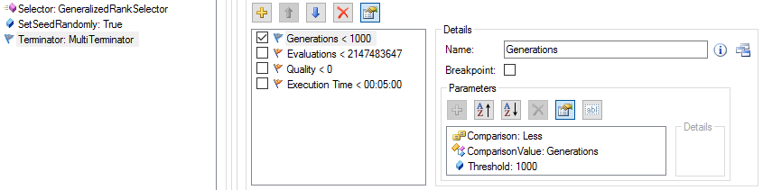
New Termination Criteria
Allows consistent termination in all algorithms
Concept to better compare algorithm performances
e.g. only allow 10⁶ evaluations for each algorithm
TerminationOperator uses MultiTerminator and cancels the algorithm if any termination criteria is not met

Slide 10
New Persistence
Redesign HL Persistence to use Google Protocol Buffers
Increase serialization/deserialization speed
Decouple structure of HL objects from persistence data format
Separate backward compatibility code from HL objects
Support different formats of HL objects and converters to transform one format into another
HL 4.0 will break persistence completely
No converters from HL 3.3.x to HL 4.0 planned

Slide 11
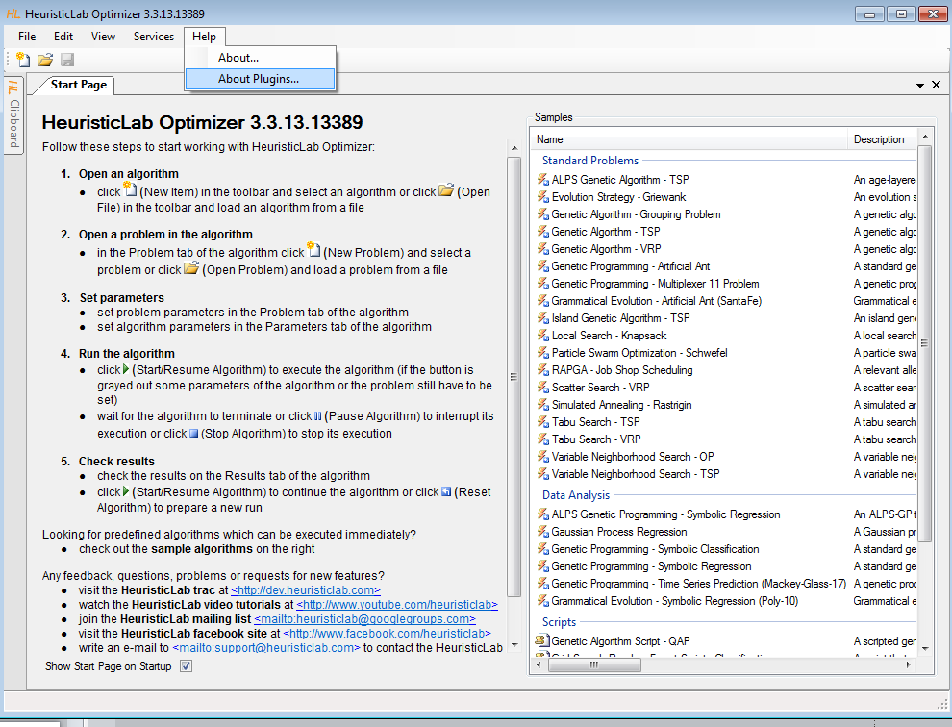
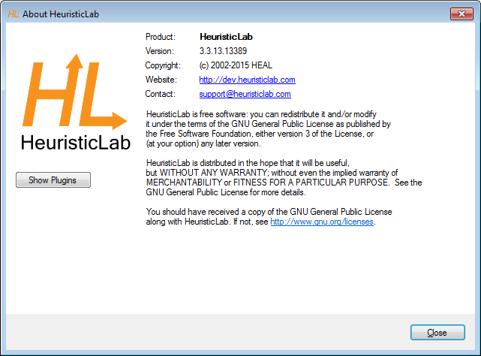
Plugin Infrastructure
Optimizer starts directly
Plugin managements integrated
ErrorHandling for Views in Mainform

Slide 12
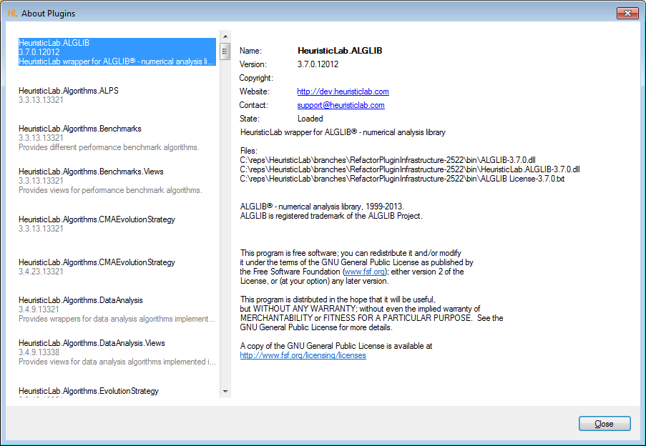
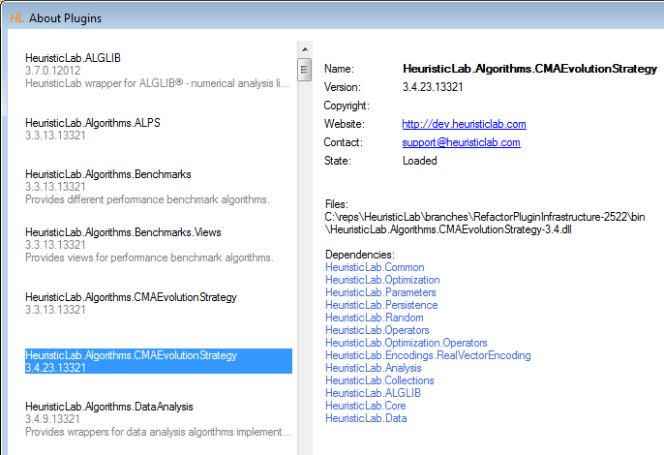
Plugin Information

Slide 13
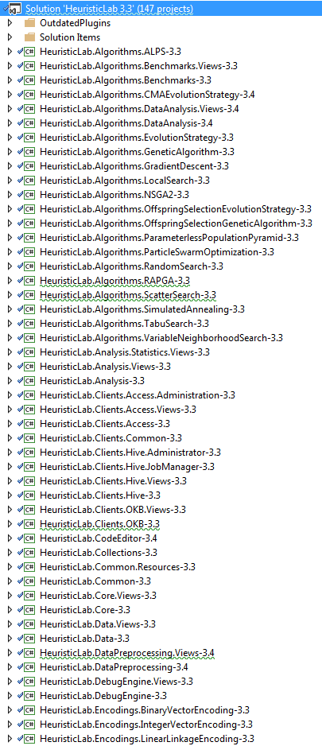
HeuristicLab Code Organization
Trunk solution contains 147 projects !!!
Fewer assemblies / plugins
~ 15 projects
Faster build times
No frame files
No dependency to SVN (SubWCRef)
Assemblies are not signed
Easier to profile
Repository layout adaptions

